Slide 1
A Game Theory Approach for Job Scheduling in Networked Manufacturing
Seminar Guide - By -
Prof D. J. Joshi Pawan Mahalle
BE (I - 12)

Slide 2
Topics
Job scheduling
Game Theory
Problem Formulation
Assumptions
Characteristics of problem
Algorithm
Result
Conclusion

Slide 3
Job Scheduling
Optimization Problem in Computer Science
Jobs need to be scheduled on Machines minimizing makespan
Complexity – (n!)*m
where, n – number of jobs
m – machines available
NP – complete Problem

Slide 4
Topics
Job scheduling
Game Theory
Problem Formulation
Assumptions
Characteristics of problem
Algorithm
Result
Conclusion

Slide 5
Game Theory
Game theory is a mathematical method for analyzing calculated circumstances.
A game consists of
- set of players
- set of strategies
- specification of payoffs for each combination
of strategies

Slide 6
Topics
Job scheduling
Game Theory
Problem Formulation
Assumptions
Characteristics of problem
Algorithm
Result
Conclusion

Slide 7

Problem Formulation
There exists M machines related to N jobs that are geographically distributive
Notation –

Slide 8
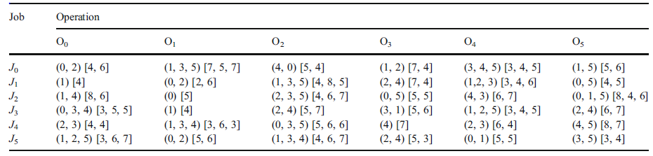
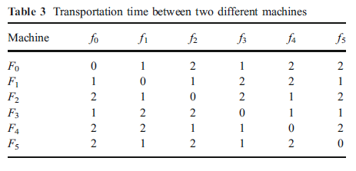
Problem Formulation (contd…)

Slide 9
Topics
Job scheduling
Game Theory
Problem Formulation
Assumptions
Characteristics of problem
Algorithm
Result
Conclusion

Slide 10
Assumptions
No job preemption
No two jobs are scheduled on the same machine at the same time
The transportation time exists
Job availability at zero time.

Slide 11
Topics
Job scheduling
Game Theory
Problem Formulation
Assumptions
Characteristics of problem
Algorithm
Result
Conclusion

Slide 12
Characteristics
Customer-centric job scheduling
Jobs having competitive relationships
Geographically distributive machines

Slide 13
Applying Game Theory
N-person non-cooperative strategy with complete information
Solution to this problem is obtained at Nash’s Equilibrium point of game.

Slide 14
Nash’s Equilibrium
Characteristic :
“An NE point is an N-tuple of strategies, one for each player, such that anyone who deviates from it unilaterally cannot possibly improve its expected payoff.”

Slide 15


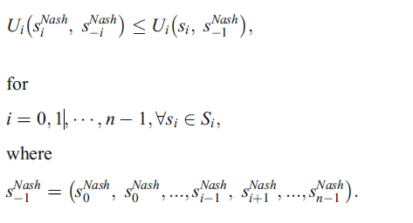
Mathematical Model
The solution profile
is characterised by -

Slide 16
Topics
Job scheduling
Game Theory
Problem Formulation
Assumptions
Characteristics of problem
Algorithm
Result
Conclusion

Slide 17
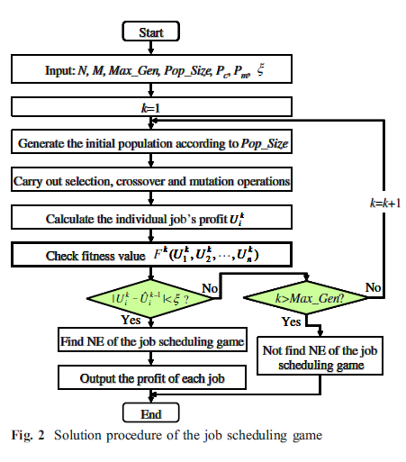
Algorithm

Slide 18
Topics
Job scheduling
Game Theory
Problem Formulation
Assumption
Characteristics of problem
Algorithm
Result
Conclusion

Slide 19
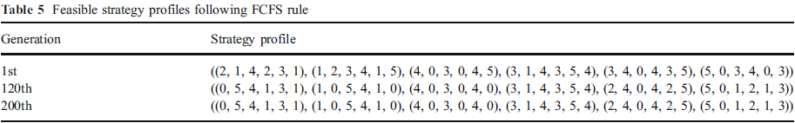
Result

Slide 20
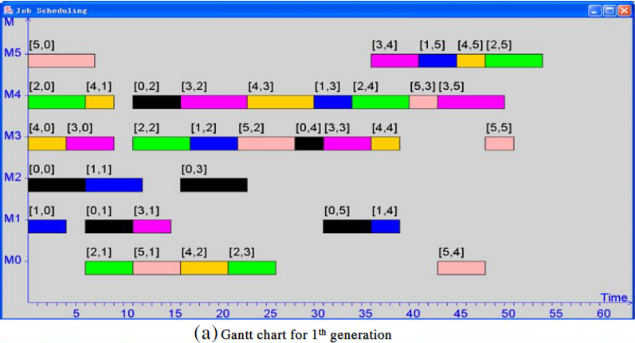
1st Generation

Slide 21
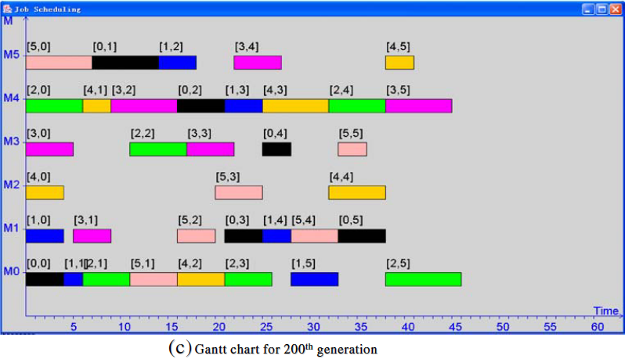
200th Generation

Slide 22
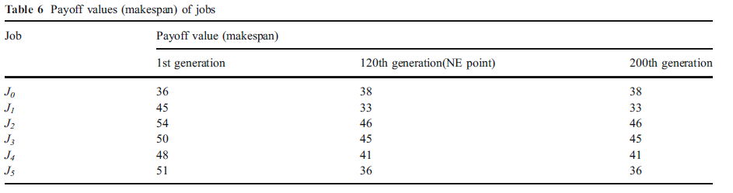
Comparision

Slide 23
Topics
Job scheduling
Game Theory
Problem Formulation
Assumption
Characteristics of problem
Algorithm
Result
Conclusion

Slide 24
Conclusion
Defined conceptual model for job scheduling in networked manufacturing
Applying n-person non-cooperative strategy with complete information gives schedule for competing jobs.

Slide 25
References
Guanghui Zhou, Pingyu Jiang, George Q. Huang(2009) A game-theory approach for job scheduling in networked manufacturing. Int J Adv Manuf Technol (2009) 41:972–985
http://academic.org/courses/game-theory
http://en.wikipedia.org/wiki/Job_shop_scheduling\
http://en.wikipedia.org/wiki/NP-complete\

Slide 26
Thank you

